Slide 1
Leetcode Workshop
Session 2 - Arrays

Slide 2
Agenda
Discussion on Arrays
Tested Topics
Practice - Remove Duplicates
Space Efficiency
Practice- Move Zeros
Practice - Sort Colours
Practice - Number of Islands

Slide 3
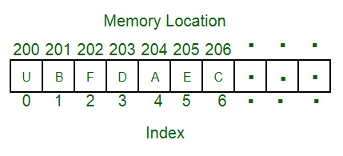
What are Arrays?
Collection of Values stored in contiguous memory locations
A zeroth index is assigned as the starting point, then so on

Slide 4
Basic Operations O(1)
Append - add value to right end of array
Pop - Remove and return value from right end of array
Lookup - Return value corresponding to the given index from the array.

Slide 5
Pros
Popping and append from the right side is extremely efficient at O(1)
Lookup is efficient
Mutable Data Structure - can update on the fly
Theoretically the easiest data structure to manipulate

Slide 6
Cons
Popping and appending from left side or middle is inefficient O(n) due to shifting operations
Certain operations like list concatenation can force one to make a new copy of the array, taking O(n)
In more low-level languages, the size of array is fixed.
In general, these problems stem from arrays being contiguous

Slide 7
Basic Operations O(1)
Append - add value to right end of array
Pop - Remove and return value from right end of array
Lookup - Return value corresponding to the given index from the array.

Slide 8
Tested Topics
Honestly, anything under the sun!
Dynamic Programming, Traversal, Backtracking, you name it. Please get comfortable with operating with Arrays!
Today’s focus will be on Programming Restrictions (Space Efficiency) and Slightly more complex implementations.

Slide 9
Code Demo

Slide 10
Programming Warmup
Remove Duplicates - https://leetcode.com/problems/remove-duplicates-from-sorted-array/

Slide 11
Hints
Read the question very, very carefully!
Checker only checks first k elements and ignores the rest
You shouldn’t produce a new array
Array is already sorted in non-decreasing order. What does this mean for duplicate numbers?
Could you use a solution with a pointer to track unique elements and another pointer to traverse through the array?
What would you do if you (do not) encounter an identical element?

Slide 12
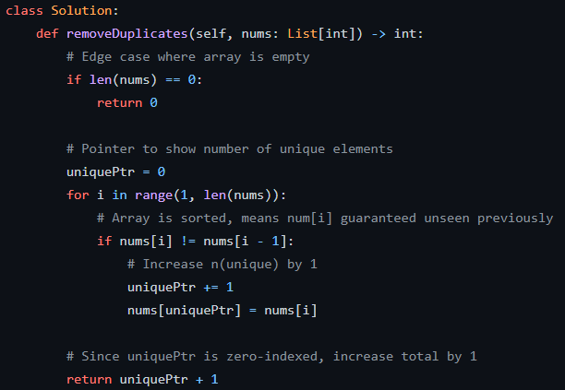
Solution

Slide 13
Programming Warmup
Move Zeros - https://leetcode.com/problems/move-zeroes/

Slide 14
Hints
You’re asked to do this in-place. What function must you use?
If you’re looping from left to right, what would you want to keep track of? Zeros or non-zeros? Any potential pitfalls?
Bonus: What if you’re looping from right to left?

Slide 15
Intuition
Loop from Left to Right (Demonstrated):
Pointer to track number of non-zeros
If track zeros, you risk swapping a zero into front
Loop from Right to Left (For overachievers):
Pointer to keep track of number of zeros
No fear of unintended swapping
Perform swapping operation as needed

Slide 16
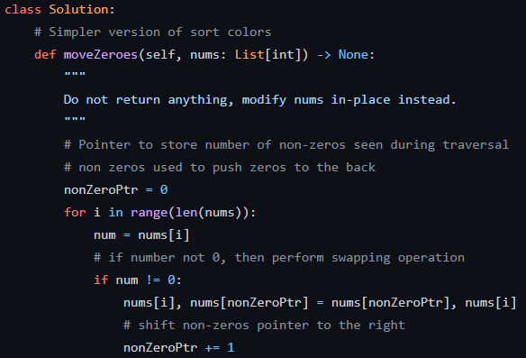
Solution

Slide 17
Challenge
Number of Islands - https://leetcode.com/problems/number-of-islands/

Slide 18
Hints
Break your program down into stages. Don’t hesitate to write auxiliary functions. They’re a mark of a good programmer.
How should your program avoid double-counting islands?
Be careful of boundary conditions!
What letters refer to rows & columns in Grid[a][b]?

Slide 19
Intuition
Traverse the entire matrix through a nested for-loop
Every instance where pointer hits a “1”, increase island count by 1
Initiate a cleanup function to mark the island as explored (change “1” to “0” on 4 directions)
Return total number of Islands

Slide 20
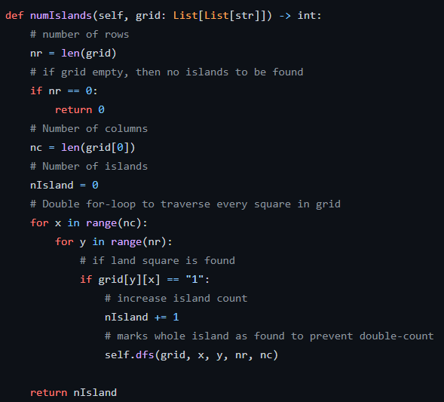
Solution - Main

Slide 21
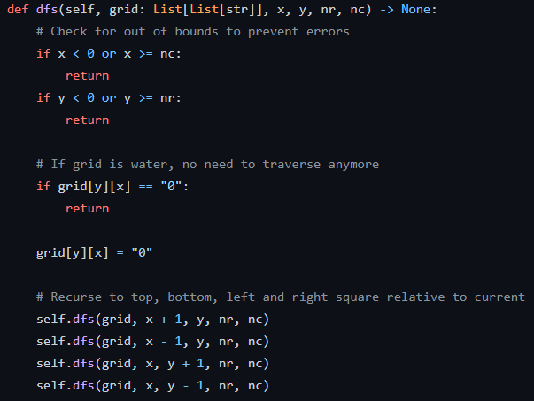
Solution - Helper

Slide 22
Challenge
Sort Colours - https://leetcode.com/problems/sort-colors/

Slide 23
Hints
Remember Moving Zeros? This problem is an extension.
2s need to be on the right while 0s need to be on the left. How would you assign these boundary pointers?
Think carefully about the conditions to be used here.
For the initiated, another straightforward solution exists.

Slide 24
Intuition
Create a boundary pointer for “2” at the last index of the array
Create a boundary pointer for “0” at the first index of the array
Traverse through the array (while-loop) and update the boundary pointers depending on the value of the current index.

Slide 25
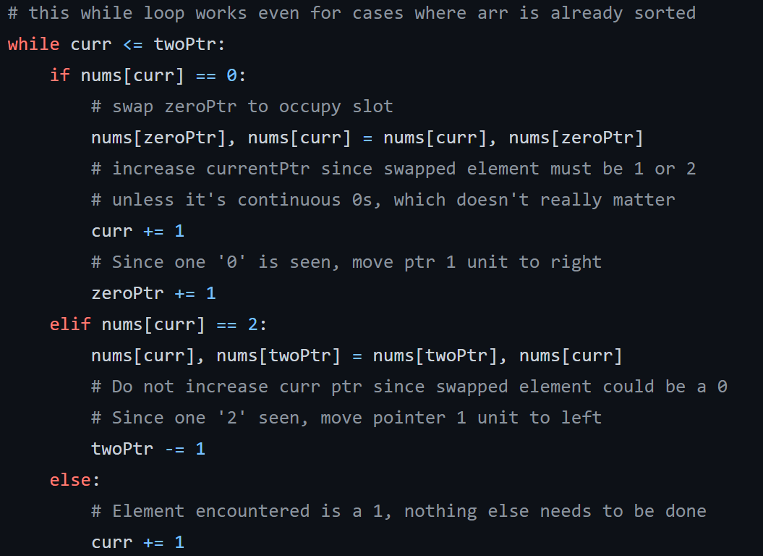
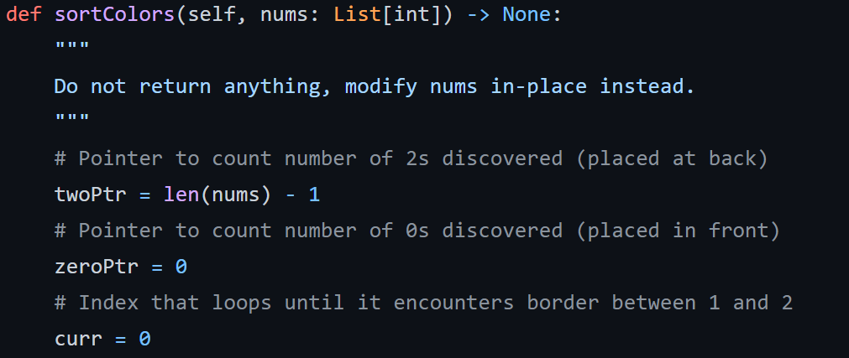
Solution

Slide 26
Thank you!
See you next week.

